Slide 1

R | Basic Text Analysis
Presented by Aviv Lo

Slide 2




Table of Contents
Topic 2
Topic 4
AI/ML/NLP Explained
R Basics
Topic 1
Topic 3
What is R?
Text Analysis

Slide 3
1
What exactly is R?

Slide 4

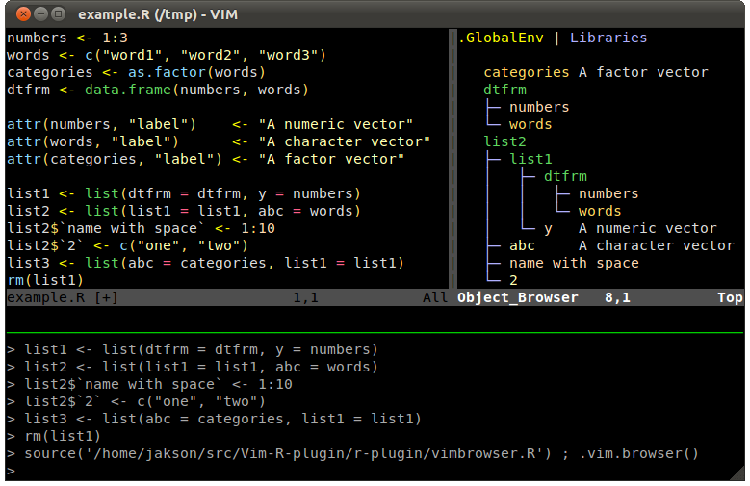
Developed by Ross Ihaka and Robert Gentleman in 1991
Hence the name “R”
Maintained by The R Foundation for Statistical Computing
Difficult for beginners + Steep learning curve
Rich and powerful visualization libraries
Support matrix / vectorized operations
It’s born for stats
Notes:
http://manuals.bioinformatics.ucr.edu/home/programming-in-r

Slide 5
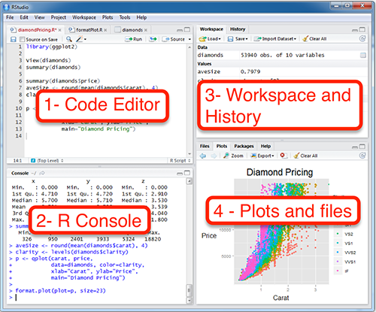
RStudio
Notes:
https://itueconomics.github.io/bil113e/r-week1.html

Slide 6
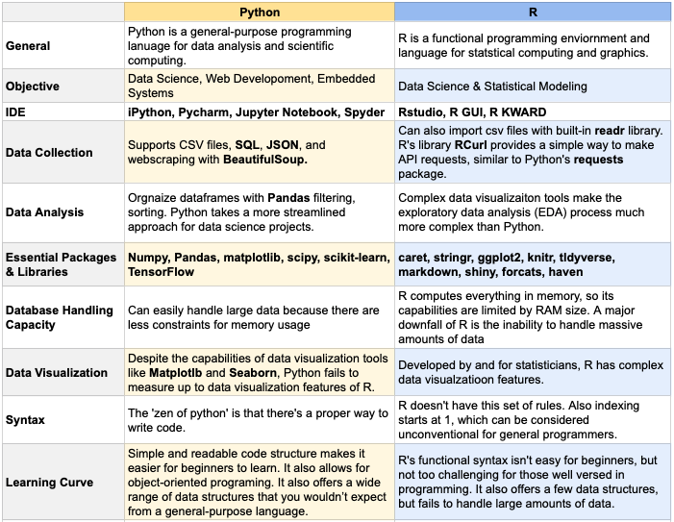
R vs. Python
Notes:
https://towardsdatascience.com/python-vs-r-the-basics-d754c45c1596

Slide 7
2
AI/ML/NLP Explained

Slide 8
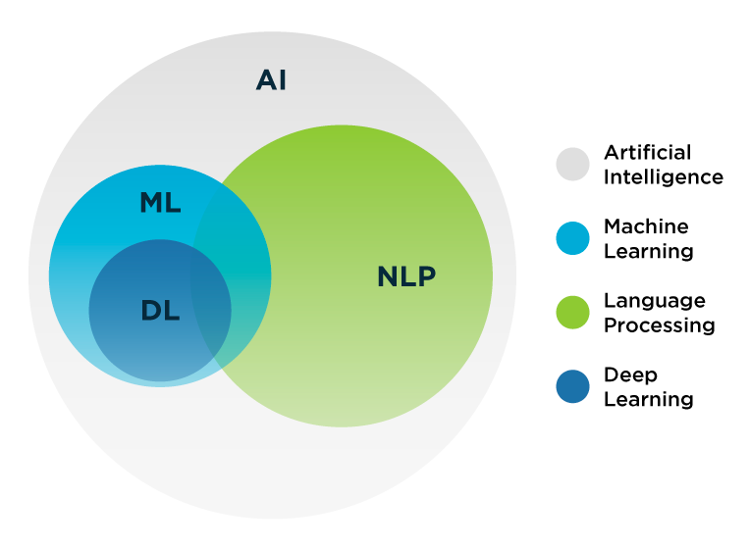
AI Domains
Notes:
https://datacenterfrontier.com/natural-language-processing-how-this-technique-can-take-your-business-to-the-next-level/

Slide 9
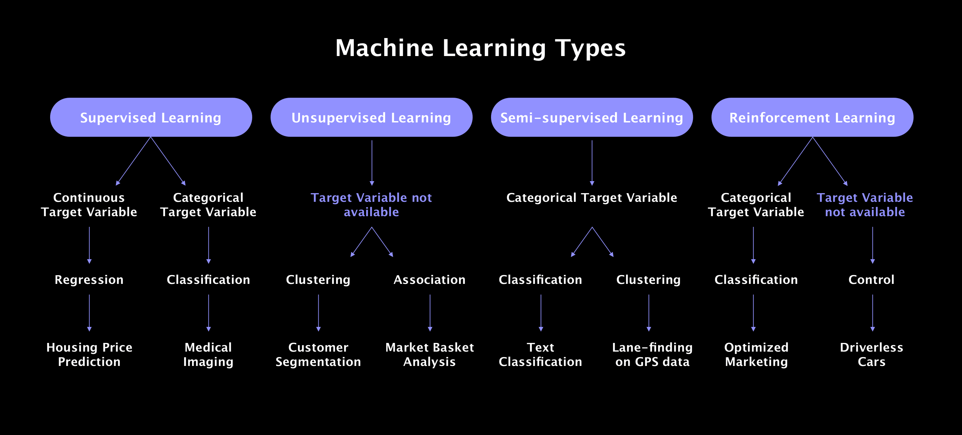
Machine Learning Family Tree
Notes:
https://litslink.com/blog/an-introduction-to-machine-learning-algorithms.

Slide 10
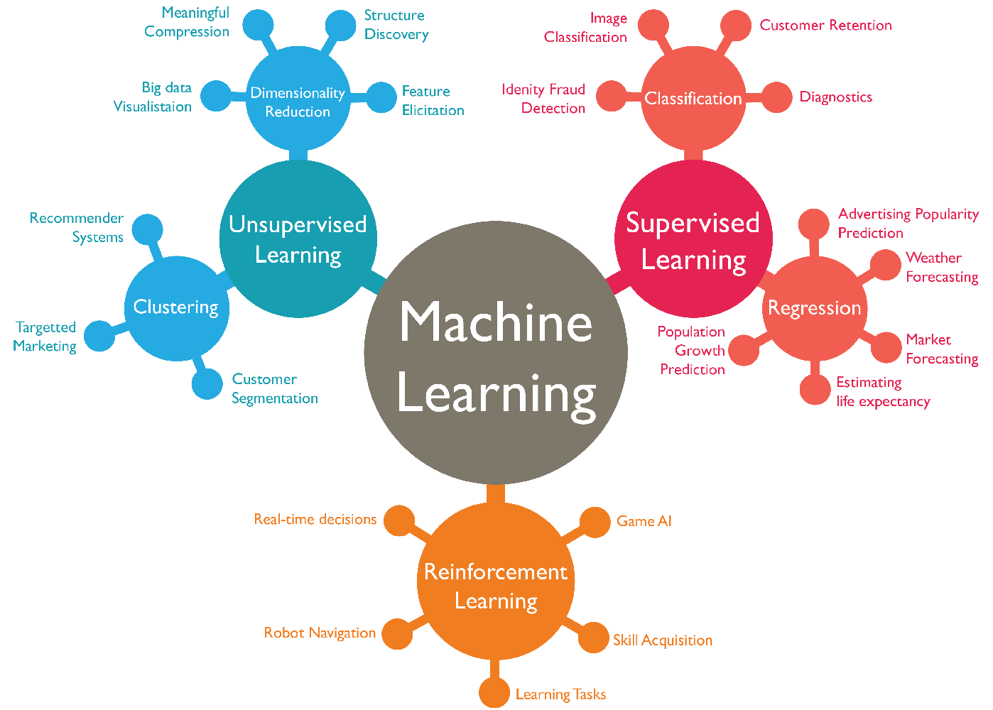
Machine Learning Family Tree
Notes:
https://www.isaziconsulting.co.za/machinelearning.html

Slide 11
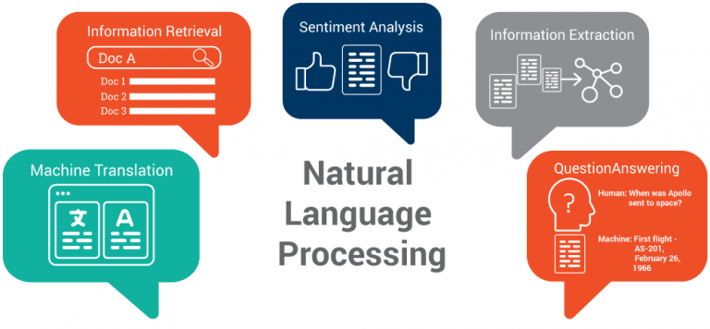
Types of NLP
Notes:
https://www.kdnuggets.com/2018/10/main-approaches-natural-language-processing-tasks.html
Information extraction
Sentiment analysis

Slide 12
3
Text Analysis
Notes:
https://www.cxtoday.com/analytics/text-analytics-vs-text-mining/
https://www.excelr.com/text-mining-vs-text-analytics

Slide 13
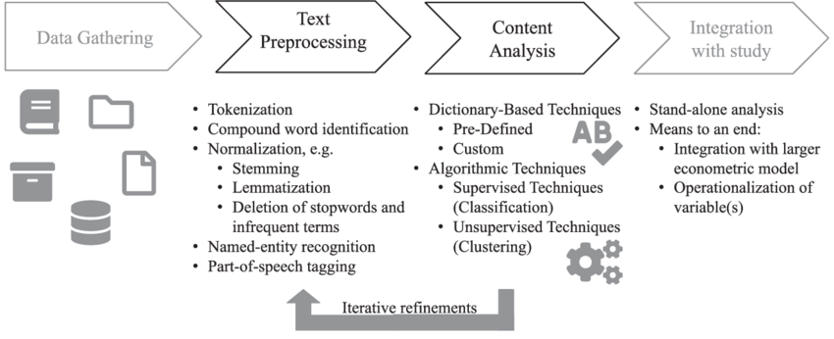
Process & Techniques
Notes:
https://www.researchgate.net/figure/Text-mining-process-and-techniques_fig1_340830772
Apply for spelling-based languages

Slide 14
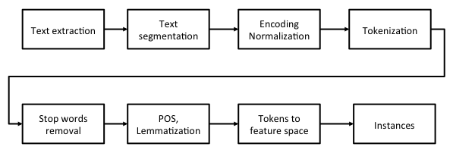
Process & Techniques
Notes:
https://subscription.packtpub.com/book/big-data-and-business-intelligence/9781788474399/10/ch10lvl1sec60/topic-modeling-for-bbc-news
https://atutor.ca/text-features/

Slide 15
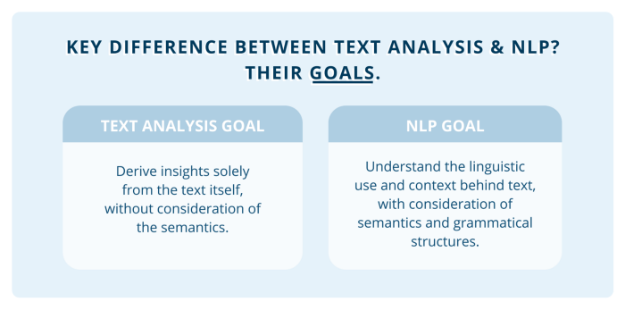
Goals
Notes:
https://towardsdatascience.com/a-guide-text-analysis-text-analytics-text-mining-f62df7b78747

Slide 16
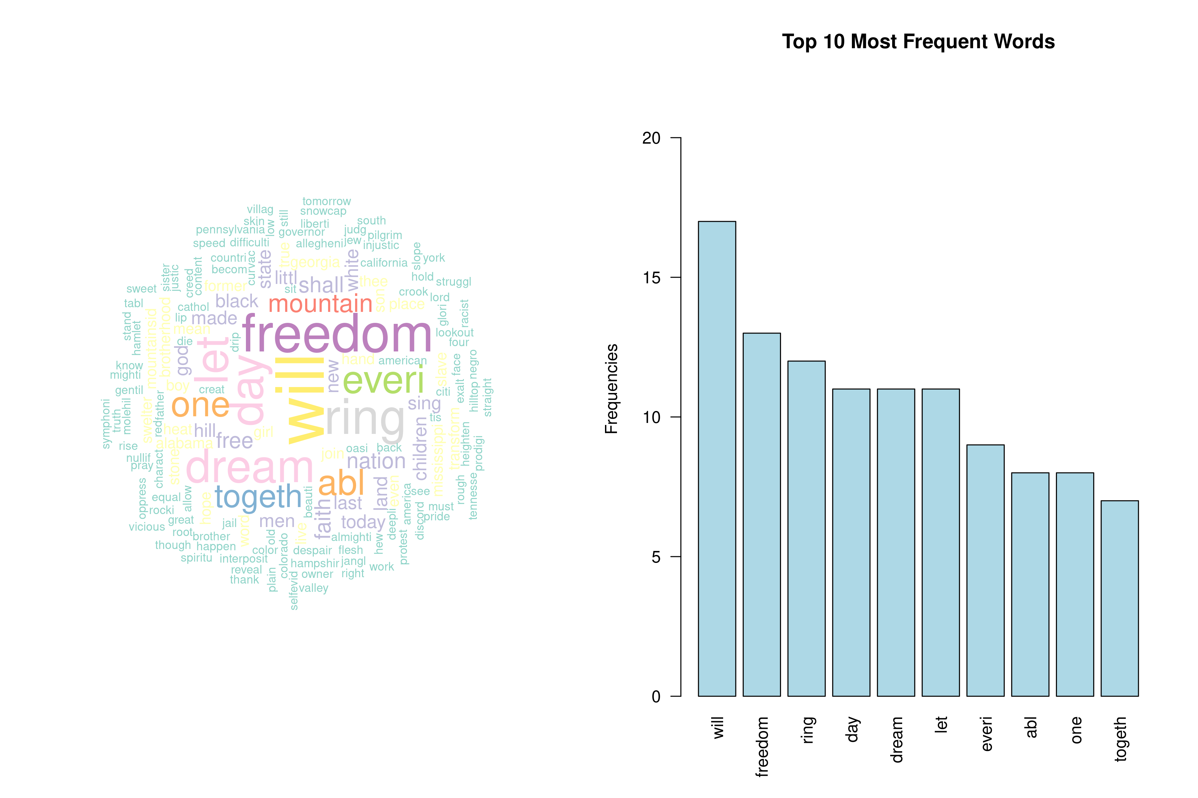
Example: Word Cloud & Word Frequency

Slide 17
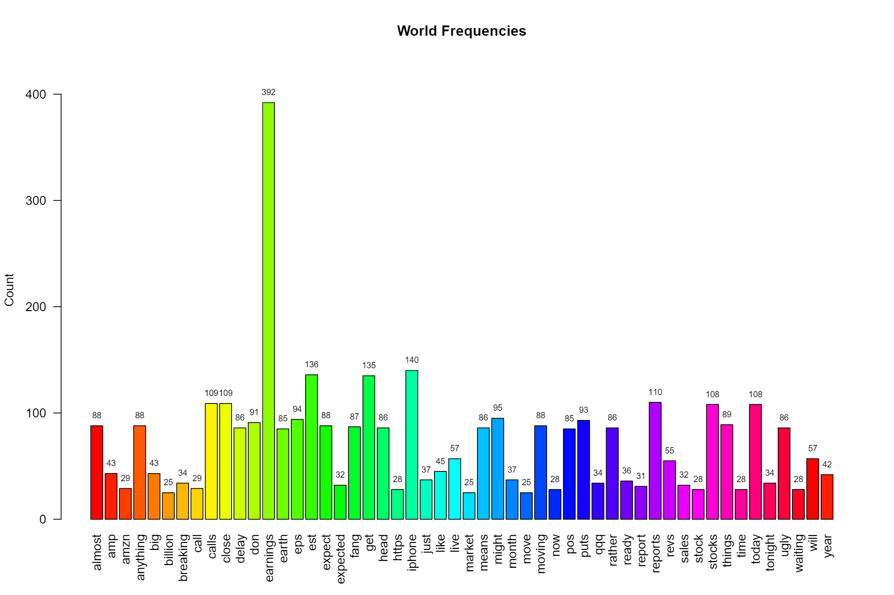
Example: Word Frequency

Slide 18
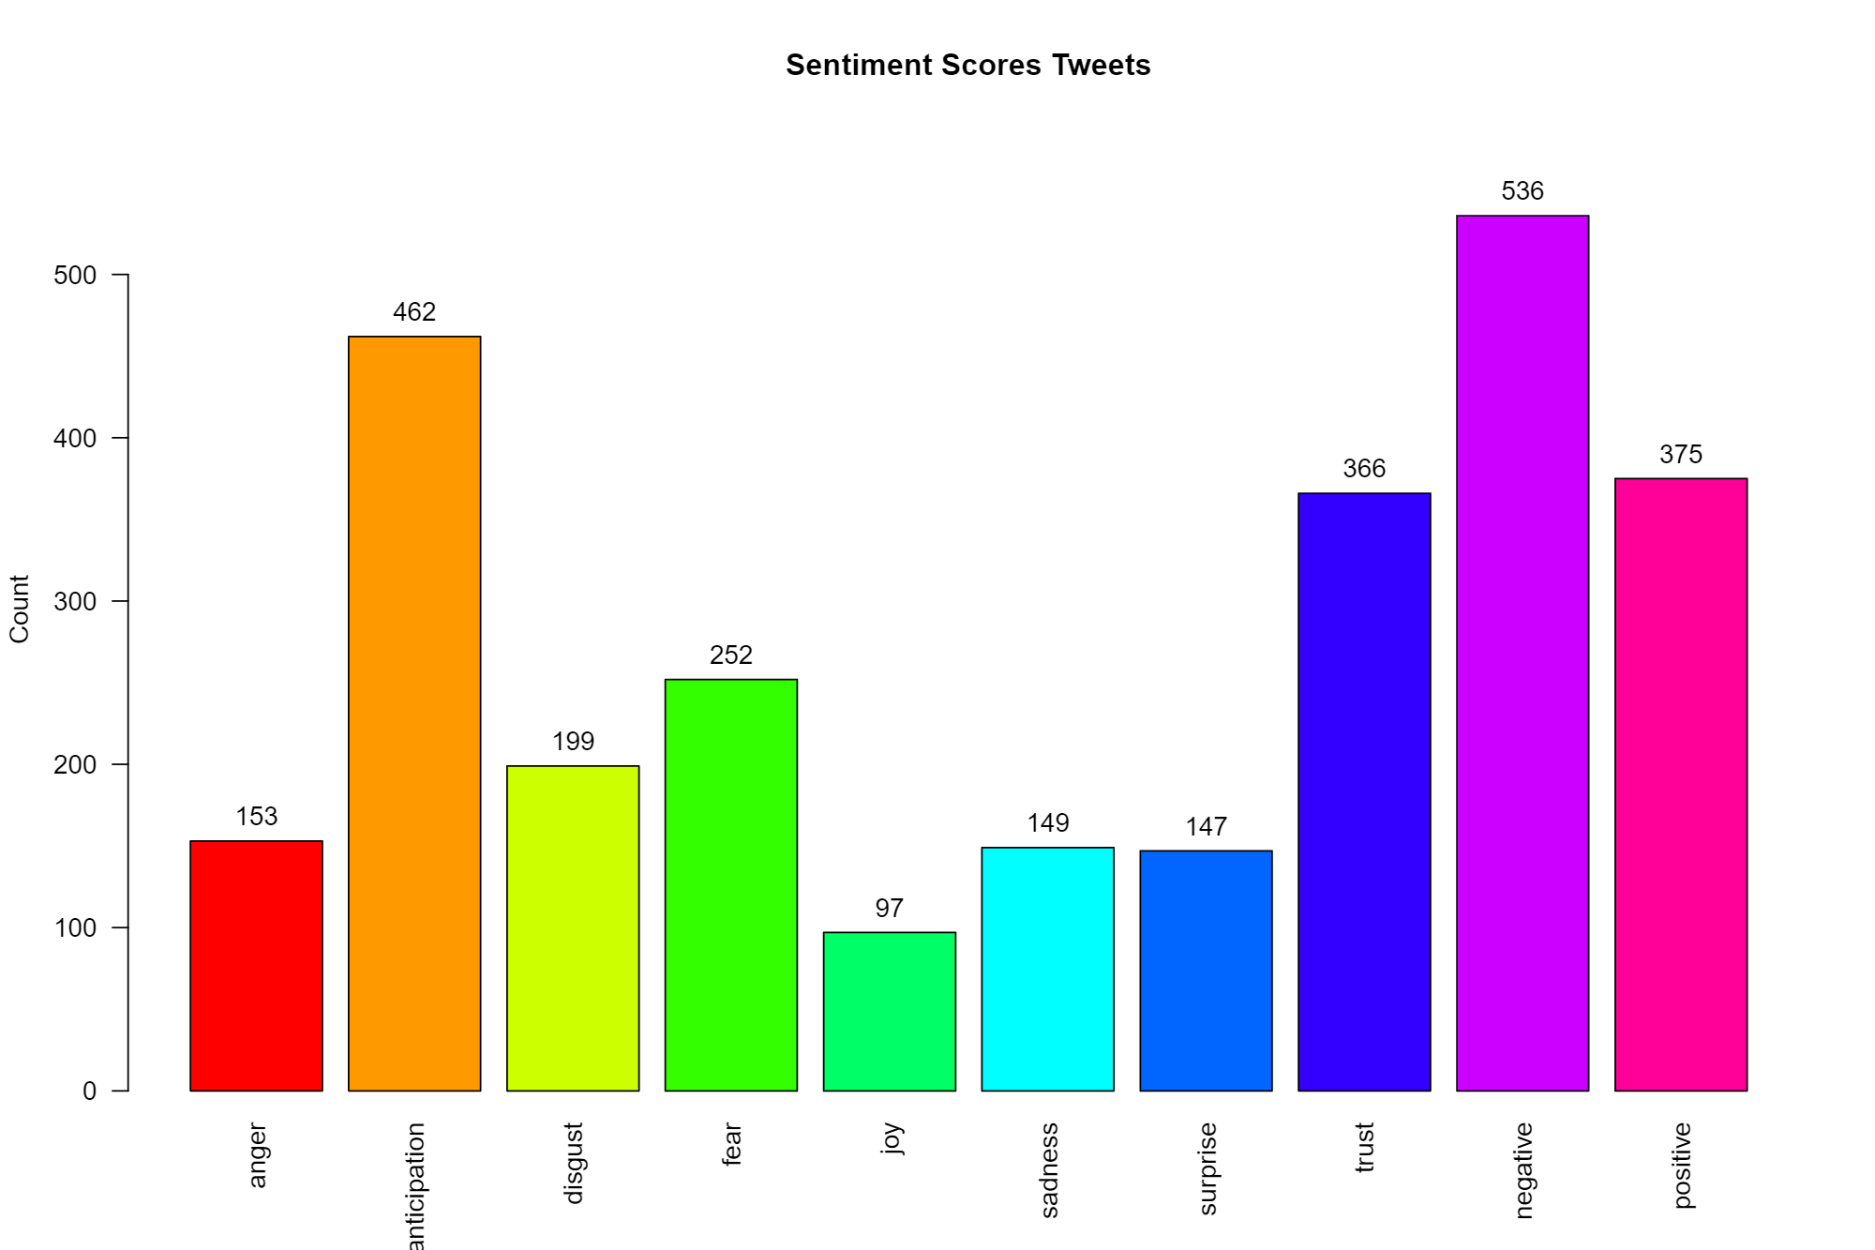
Example: Tweet Sentiment

Slide 19
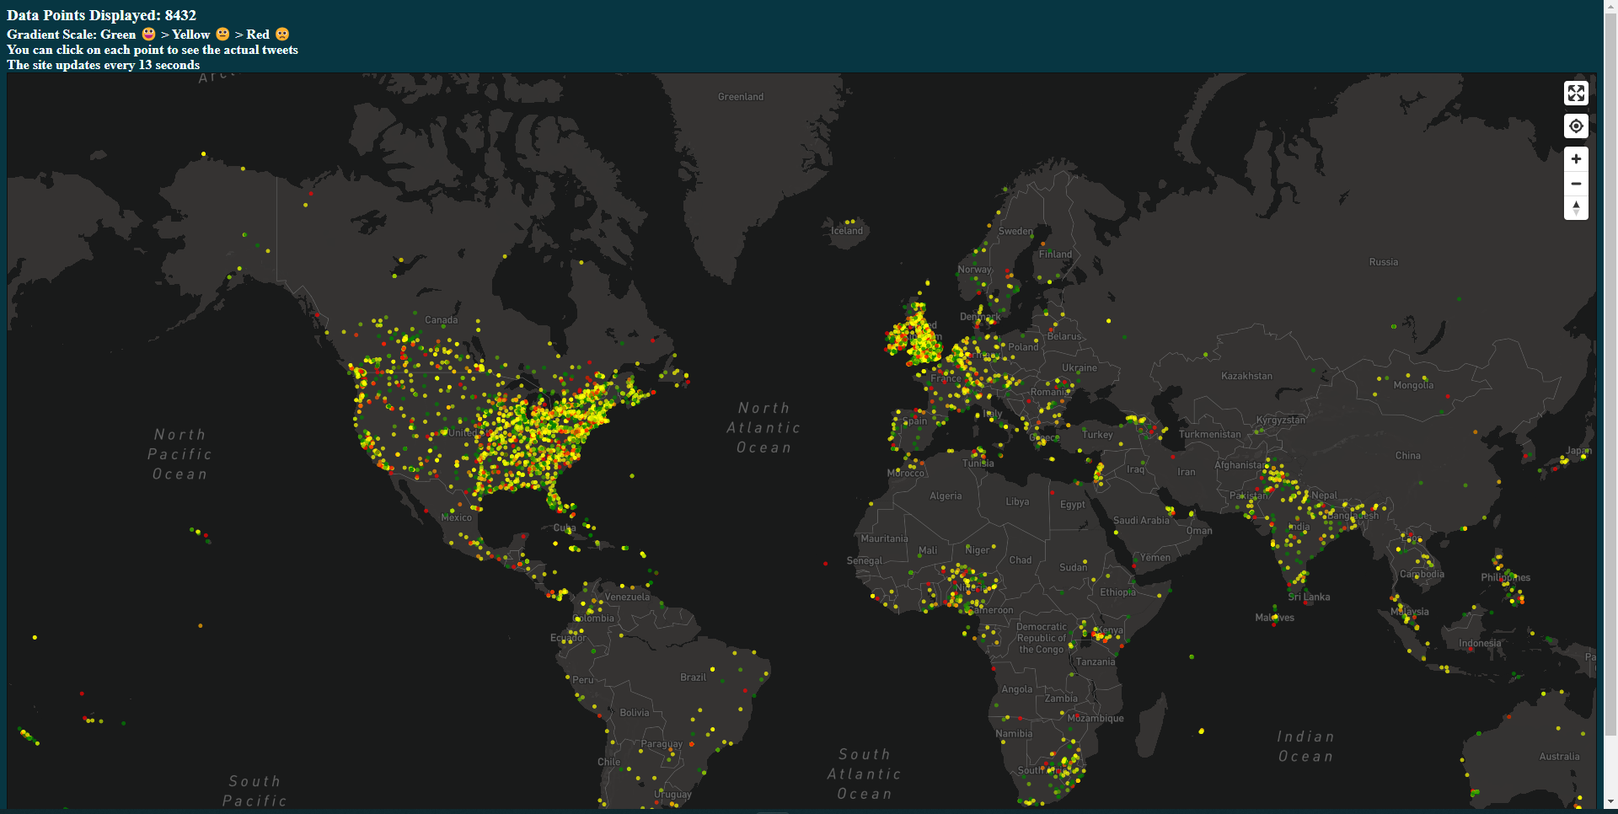
Examples: Covid Sentiment Map
Notes:
https://moodli.org/

Slide 20
4
R Basics

Slide 21

R Basics
Data Types
Character & Double & Integer & Logical & Complex
Data Structures
Matrix & Data Frame
List & Vector
Factor
Variable Assignment
x ← 1
y ← c(“apple”, ”orange”)
car_speeds <- read.csv(file = ‘./car-speeds.csv')
Accessing Data Frame
Data_Frame[row, col]
Data_Frame$Column_Name
Notes:
https://swcarpentry.github.io/r-novice-inflammation/13-supp-data-structures/#:~:text=R's%20basic%20data%20types%20are,%2C%20data%20frame%2C%20and%20factors.

Slide 22
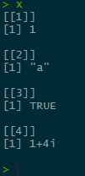
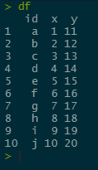
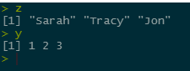
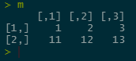
R Basics: Data Structure Examples
List
Data Frame
Vector
Matrix

Slide 23
R Basics: Exploring Your Data
nrow() & ncol()
Gives you the number of rows of the dataset
Gives you the number of columns of the data set
head() & tail()
Gives you the top 6 rows of the data set
Gives you the bottom 6 rows of the data set
str()
Gives you the structure of the data set
dim()
Gives you the dimension (row, col) of the data set
summary()
Gives you a summary of your data set
Ex: min, max, mean, IQR, number of categorical variables …etc.

Slide 24
R
Let’s Code

Slide 25
Thank You

